Slide 1
Please view this presentation in “Slide Show” mode, it contains fancy animations.
Jason Moran Old Dominion University 9/13/2020
Load.In Moving Truck Loading Helper

Slide 2

Load.in
Give your move a game plan.
Jason Moran
Old Dominion University
9/13/2020
Notes:
Hello everyone, my name is Jason Moran.
In my time outside of academia, I've had the privilege to work on a lot of cool Reality Capture and 3D modeling solutions. Those experiences inspired this project.
I'm here today to pitch Load In, a technology that utilizes photogrammetry to take the hassle out of Moving Day.

Slide 3
Contents
What’s the problem?
What’s the solution?
Is it possible?
Where’s the money?
What if it doesn’t work out?
Notes:
Today we'll be covering the problem that Load.In solves, as well as the technology it uses under the covers.
I'll also briefly go over the feasibility of the project, my thoughts on the business model, and potential alternatives.

Slide 4
“What’s the problem?”
Notes:
"So.. what problem ARE we trying to solve?" you might be thinking.

Slide 5
Moving is more stressful than... ...Planning a Wedding (20%) ... A Job Interview (27%) ...A week in jail (13%)
NYPost.com
Notes:
Well, moving is stressful.
According to a survey by Life Storage, moving is considered by some to be more stressful than planning a wedding, a job interview, or even a week in jail. I found that last one surprising.

Slide 6
Moving is more stressful than... ...Planning a wedding (28%) ...Having a child (16%) ...Starting a new job (20%)
Article.com
Notes:
Article.com ran a similar survey with results that corroborate Life Storage's survey.
A good 16% of those who took the survey felt moving was more stressful than having a child!

Slide 7
“Changing Residences” appears on the Holmes-Rahe Life Stress Inventory.
Stress.org
Notes:
"Well, maybe that 16% was all men", you're thinking. We'll never know for sure!
Survey results aside, "changing residence" is one of the 43 items on the Holmes-Rahe Life Stress Inventory, which is used to gauge someone's likelihood of falling ill based on the stressors in their life.
Now, "changing residence" isn't at the top of the list by any means,
but the fact that it's on the list at all solidifies it's place as a stressful life event.

Slide 8
36% of Americans are stressed the most by the logistics of Moving Day.
Article.com
Notes:
But what about moving stresses people out so much? There are many factors, but Load.In focuses on one:
According to Article.com's survey, 36% of Americans are stressed the most by the logistics of moving day.

Slide 9
More time is spent on “hard labor” than any other task on Moving Day.
NYPost.com
Notes:
On a similar note, the responders to Life Storage's survey indicated that, on loading day, they spent more time on hard labor: which I presume entails
loading and unloading the truck than any other activity. Logistics and Labor are the two key areas that Load.In focuses on.

Slide 10
Moving Day sucks.
Notes:
So, Pardon my bluntness, but I think it's safe to say that moving day SUCKS.

Slide 11
“So what do we do about it?”
Notes:
At this point, perhaps you're thinking "OK, alright, it sucks, but what is there to be done about it?"

Slide 12


1. Use a phone camera to capture multiple images of objects that need to be loaded.
Notes:
To answer that, let me present to you Load.In's 4 step process to simplifying moving day.
First, the end user takes pictures of their packed belongings from multiple camera angles using their smartphone.

Slide 13




2. Using photogrammetry, create 3D models from those images
Notes:
Next, Load.In uses photogrammetry to create 3D models from those images.

Slide 14
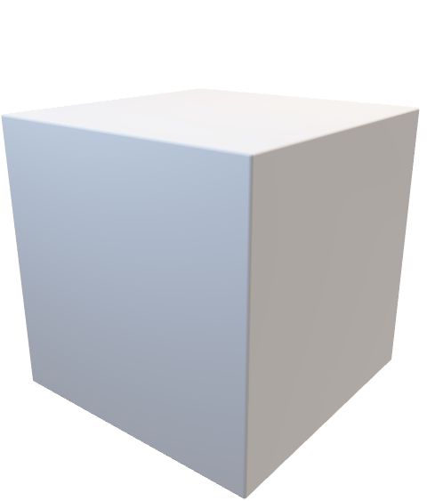
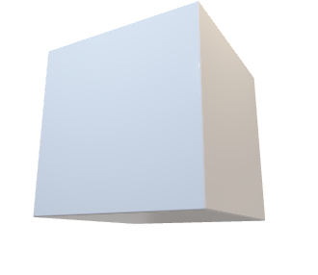



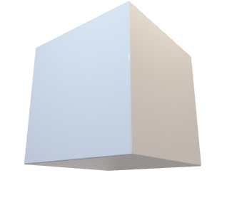
3. Calculate optimal loading configuration and provide loading instructions to the user
Notes:
Once the 3D models are created, Load.In knows the full dimensions of each object that needs to be loaded on to the truck.
Using that information, it generates a set of step-by-step instructions to guide the user to use their truck's space in an optimal way.
This turns loading the truck from an adventure in frustration to a checklist.

Slide 15
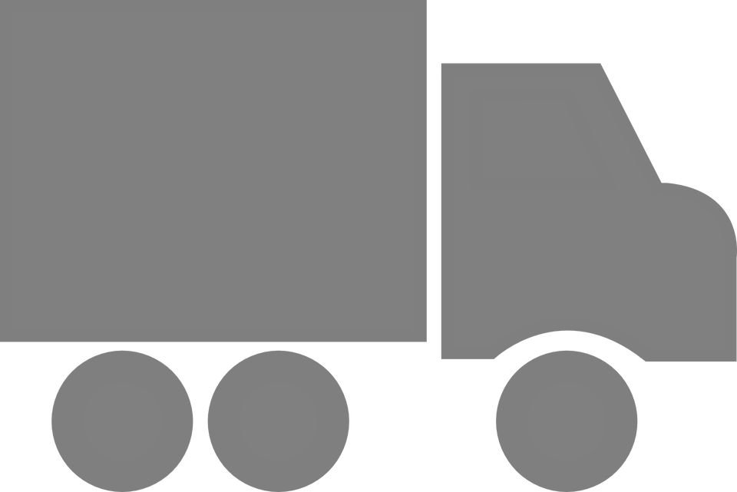
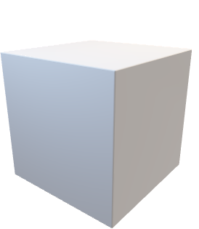





4. The user can navigate a 3D map showing the location of every box in the truck
kitchen
garage
Notes:
Because Load.In generated a step by step guide to filling the truck, it already knows the exact location of each box in the truck. Using this information, Load.In can generate a 3D map of the inside of the truck to assist in the user in the unloading process. They'll never lose track of a box!

Slide 16
“Is this even feasible?”
Notes:
Now you're probably thinking "is it too good to be true? Is that feasible?"

Slide 17
Photogrammetry, creating 3D models from 2D images, is a proven technology. It’s used today by Google Earth, as well as in the entertainment industry to create realistic 3D models.
YouTube.com, Medium.com
Notes:
There will be plenty to figure out, but at a basic level, photogrammetry is a proven technology.
It's used in Google Earth, in the entertainment industry, and I've personally seen it used in construction and in surveying.

Slide 18

Old Dominion University, as seen on Google Earth.
Notes:
As an example, here’s a 3D view of ODU generated by Google Earth.

Slide 19
2D “Packing Algorithms” are already proven and are heavily used in manufacturing to minimize material waste.
CADCode.com
Notes:
When it comes to the packing instructions: 2D solutions already exist in manufacturing. When cutting parts from sheet metal, shapes need to be arranged to minimize the amount of wasted material.

Slide 20
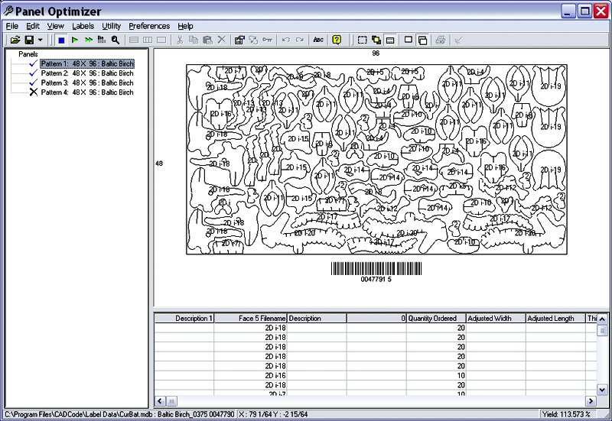
2D packing at work for manufacturing.
CADCode.com
Notes:
Here’s an example of the result of a 2D packing algorithm. CADCode is able to arrange these odd shapes to minimize material waste when they’re cut out of sheet metal.

Slide 21
3D “Packing Algorithms” aren’t as proven, but there is prior work.
SemanticScholar.org
Notes:
Translating this algorithm to 3 dimensions is no small task, but there is prior work in this field, so we wont be starting from scratch.

Slide 22
Professional movers already have their own “algorithm” for loading a truck that we may be able to mimic.
YouTube.com
Notes:
Of course, we can also learn from professional movers. I hope to mimic their packing strategies to improve our "packing algorithm“’s results.

Slide 23
“So we sell families that are moving an app to help them plan their move?”
Notes:
Alright, so we sell families that need to move an app to help them in the process, right?

Slide 24
The moving family is the end user... But truck rental companies are the real customer.
Notes:
Well.. not quite. The moving family is the end user, but Truck Rental companies are the REAL customer for this product.

Slide 25
How do you market an app that people only need a few times in their life? Catch them when they need it most.
Notes:
The reason is simple:
How do you market an app that makes moving day easy when people don't need it very often?
Load.In isn't like Alexa: Seeing a commerical for it on TV probably won't convince a family to up and move on a whim.
So, you have to engage that family when they need it most: when they get a rental truck.

Slide 26
31,000,000 Americans moved in 2019. 45% of those people rented a moving truck.
MoveBuddha.com
Notes:
That shouldn't be too hard if we team up with truck rental companies. That team up is already a good move for us, considering 45% of Americans already rent moving trucks instead of employing movers or using their own vehicles.

Slide 27
Load.In gives truck rental companies a real competitive edge and simplifies our work.
Notes:
A rental company that offers access to Load.In for the duration of a truck rental has a more complete solution than their competition:
they can offer both a truck and, with Load.In, professional, customized instructions on loading the truck all for far less than the cost of professional movers.
Licensing the technology is beneficial for us as well, with the rental company handling marketing and sales, our organization can remain more focused on improving the technology.

Slide 28
“What if this doesn’t work out?”
Notes:
Alright, we've got a business plan, a technology, but "what if it doesn't work out?" the pessimist in the back of your mind says.

Slide 29
Storage Units, Packing Suitcases, Organizing a pantry: this technology has many potential use cases!
Notes:
Well, A photogrammetry based packing solution has a lot of potential use cases. If something doesn't work out for either technological or business reasons, we may be able to switch to a different market to compensate. That also means there are many ways we can expand our business beyond truck rentals.

Slide 30
In Summary:
Moving is a stressful life event
A photogrammetry app can make moving logistics simple
License technology to truck rental companies
Engage end users where they’re most in need of our service
45% of people moving use rental trucks already
This technology helps truck rental companies sell the “full solution”
If something goes wrong, there are plenty of ways we can pivot.
Notes:
To wrap things up: Load.In seeks to use photogrammetry to simplify a stressful life event: moving.
By licensing this technology to a rental truck company, we can make that company's offerings more appealing and catch end users where they need us most.
Rental Truck companies already own a majority of the market.
If something goes sideways, there's plenty of other ways this technology can go.

Slide 31
Notes:
Thank you for listening to my presentation!

Slide 32
Sources:
https://nypost.com/2019/05/08/one-in-ten-americans-would-prefer-a-week-in-jail-over-moving/
https://www.article.com/blog/top-5-moving-mistakes/
https://www.stress.org/holmes-rahe-stress-inventory
https://www.movebuddha.com/blog/moving-industry-statistics/
https://youtu.be/suo_aUTUpps
https://medium.com/@homicidalnacho/a-look-into-photogrammetry-and-video-games-71d602f51c31
https://youtu.be/rjmofUZOdwo
https://www.cadcode.com/category/categories/optimizing-machining
https://www.semanticscholar.org/paper/OPTIMIZING-THREE-DIMENSIONAL-BIN-PACKING-THROUGH-Dube/bb9986af2f26f7726fcef1bc684eac8239c9b853?p2df
Notes:
(no recording)

